Slide 1

Decode Gaming Behavior
Presented By Nagendra V Kini

Slide 2


Project Objective
The objective of the project is to analyze gaming data to gain insights into player behavior, preferences, and engagement patterns. By examining various aspects of gaming activity, the project aims to understand what drives player interactions within games and how game developers can optimize the gaming experience.
Tools Used

Slide 3
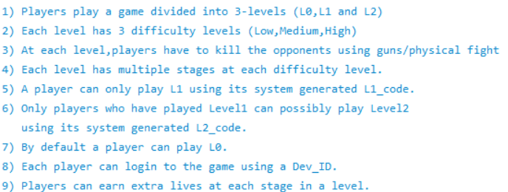
Dataset Overview

Slide 4
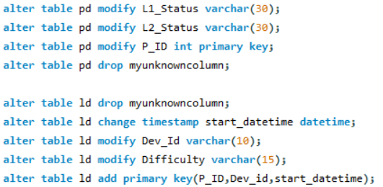
Data Exploration With SQL
Correcting The Data
Two Tables Are There 1) player_details 2) level_details

Slide 5
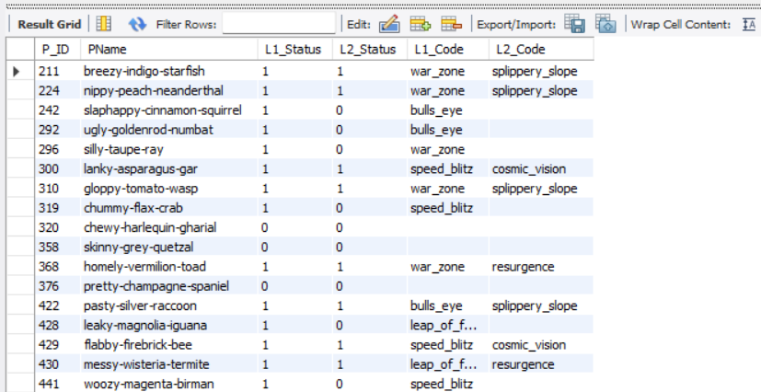
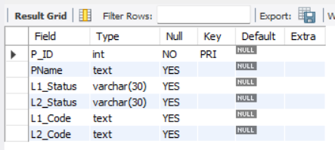

Slide 6
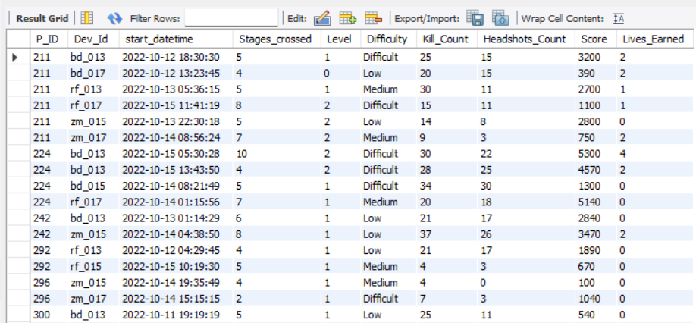
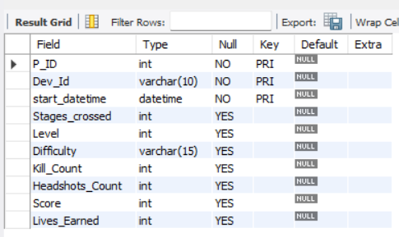

Slide 7
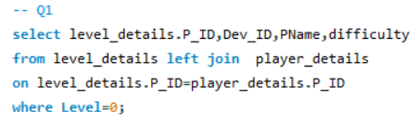
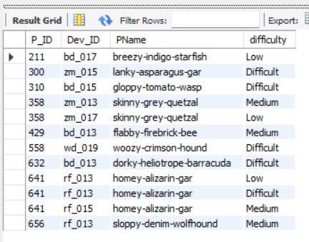
Insight :- We have obtained records for 12 players along with their corresponding difficulty levels at Level 0.

Slide 8
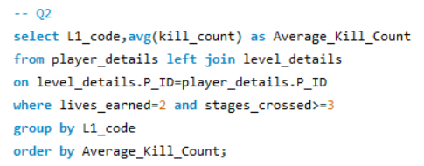
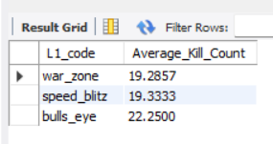
Insight :- In this Level 1 scenario, specifically in Stage 3 where players earn 2 lives, the 'bulls_eye' code stands out with the highest average kill count.

Slide 9

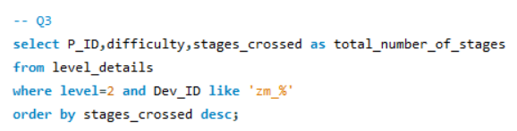
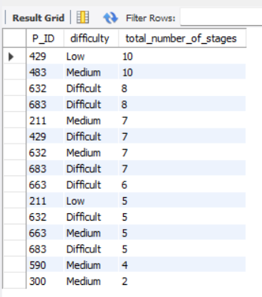
Insight :- In Level 2, among players using the ZM-Series device, we've gathered data indicating that player ID 429, playing at the low difficulty level, has crossed the highest number of stages. Similarly, at the medium difficulty level, player ID 483 has achieved the highest stage count. Moreover, players ID 632 and 683, tackling the difficult level, have both crossed the highest number of stages.

Slide 10
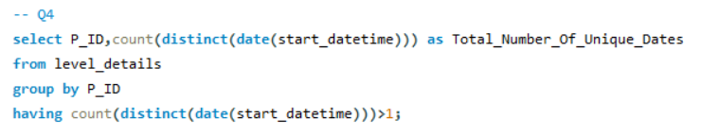
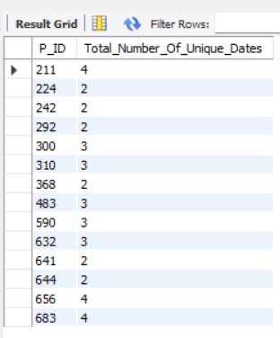
Insight :- We have the player ID 211,656,683, Who participated in the game on several occasions.

Slide 11
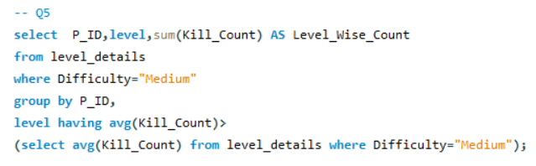
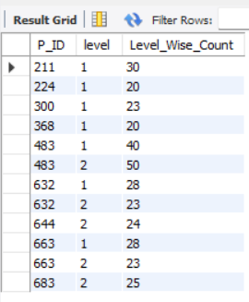
Insight :- In Level 1, player ID 483 has the highest sum of kill count, exceeding the average kill count for the medium difficulty level. Similarly, in Level 2, player ID 483 also achieves the highest sum of kill count, surpassing the average kill count for the medium difficulty level.

Slide 12
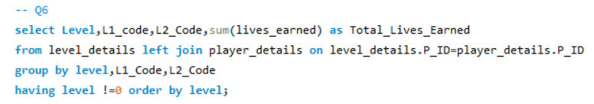
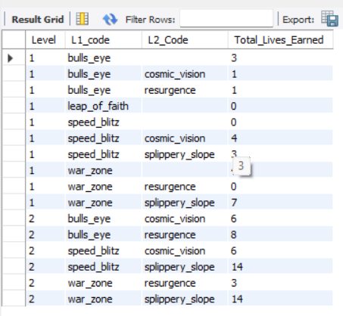
Insight :- Excluding Level 0, we've identified 16 records detailing the level and its corresponding code-wise sum of lives earned.

Slide 13
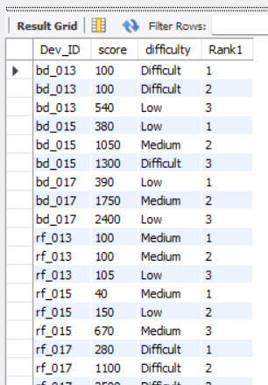
Insight :- We identified the top 3 scores for each device ID, ranked them in ascending order, and displayed the corresponding difficulty level alongside.

Slide 14
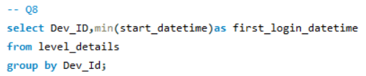
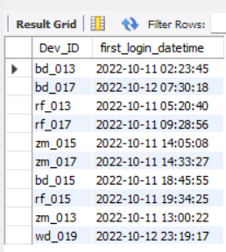
Insight :- We discovered the initial login datetime for each device ID.

Slide 15
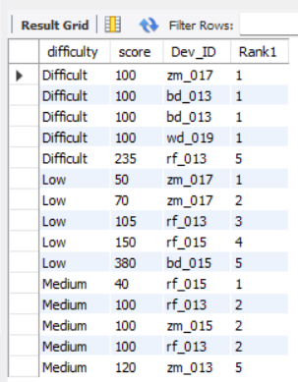
Insight :- We identified the top 5 scores for each difficulty level, ranked them in ascending order, and included the corresponding device ID. Additionally, we found that in the difficult difficulty level, the highest score is 235. In the low difficulty level, the highest score is 380. Lastly, in the medium difficulty level, the highest score achieved is 120.

Slide 16

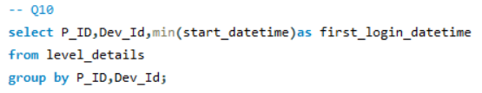
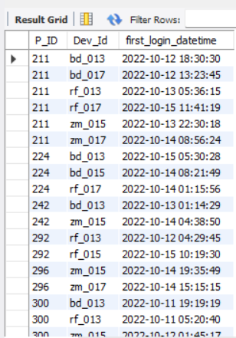
Insight :- We've identified the Device ID that is First logged in for each Player ID.

Slide 17

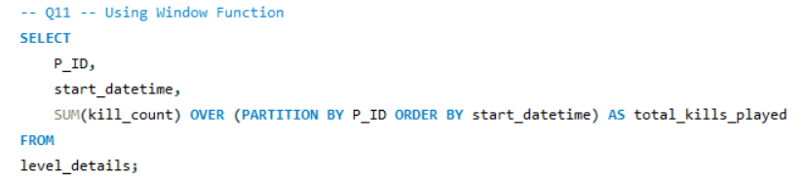
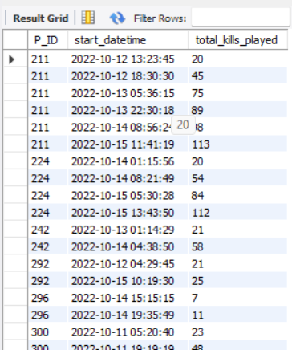
Insight :- We've gathered the date and total kill count for each player, representing the cumulative number of games played by each player up to that date.

Slide 18
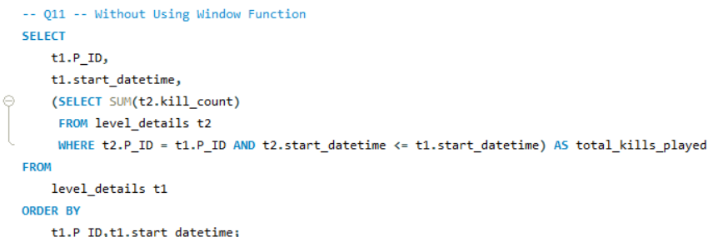
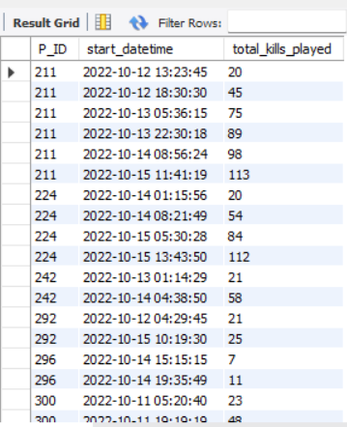
Insight :- We've gathered the date and total kill count for each player, representing the cumulative number of games played by each player up to that date.

Slide 19
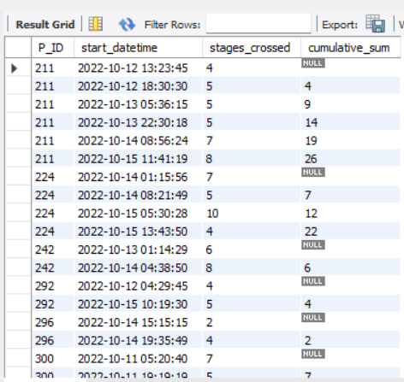
Insight :- We calculated the cumulative sum of stages crossed over time for each player ID, excluding the most recent start datetime.

Slide 20
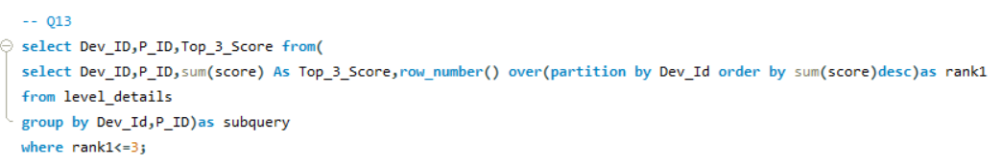
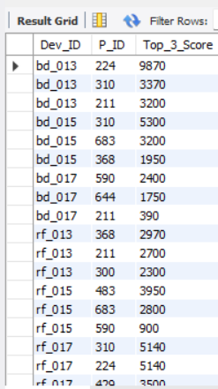
Insight :- I extracted the top three highest sums of scores for each device ID along with their corresponding player IDs.

Slide 21
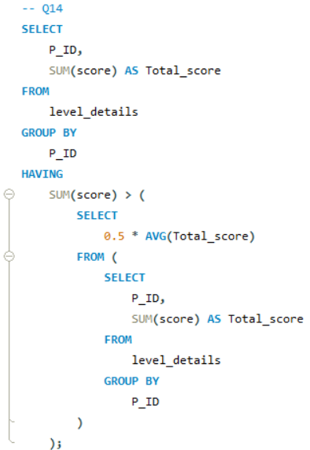
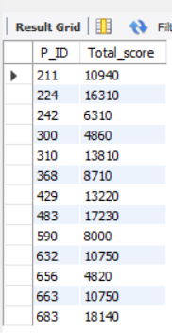
Insight :- We identified players who scored more than 50% of the average score, calculated by the sum of scores for each player ID.

Slide 22
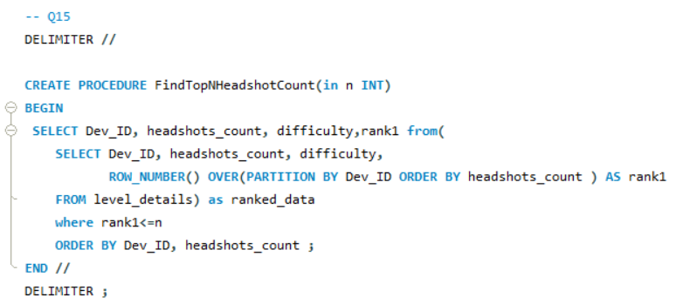
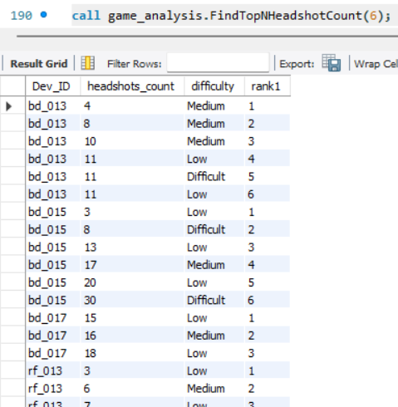
Insight :- I've identified the top N headshot counts for each device ID, ranked them in ascending order, and also displayed the corresponding difficulty level.

Slide 23
Insights
We have obtained records for 12 players along with their corresponding difficulty levels at Level 0.
In this Level 1 scenario, specifically in Stage 3 where players earn 2 lives, the 'bulls_eye' code stands out with the highest average kill count.
In Level 2, among players using the ZM-Series device, we've gathered data indicating that player ID 429, playing at the low difficulty level, has crossed the highest number of stages. Similarly, at the medium difficulty level, player ID 483 has achieved the highest stage count. Moreover, players ID 632 and 683, tackling the difficult level, have both crossed the highest number of stages.
We have the player ID 211,656,683, Who participated in the game on several occasions.
In Level 1, player ID 483 has the highest sum of kill count, exceeding the average kill count for the medium difficulty level. Similarly, in Level 2, player ID 483 also achieves the highest sum of kill count, surpassing the average kill count for the medium difficulty level.
Excluding Level 0, we've identified 16 records detailing the level and its corresponding code-wise sum of lives earned.
We identified the top 3 scores for each device ID, ranked them in ascending order, and displayed the corresponding difficulty level alongside.
We discovered the initial login datetime for each device ID.
We identified the top 5 scores for each difficulty level, ranked them in ascending order, and included the corresponding device ID. Additionally, we found that in the difficult difficulty level, the highest score is 235. In the low difficulty level, the highest score is 380. Lastly, in the medium difficulty level, the highest score achieved is 120.
We've identified the Device ID that is First logged in for each Player ID.
We've gathered the date and total kill count for each player, representing the cumulative number of games played by each player up to that date.
We calculated the cumulative sum of stages crossed over time for each player ID, excluding the most recent start datetime.
I extracted the top three highest sums of scores for each device ID along with their corresponding player IDs.
We identified players who scored more than 50% of the average score, calculated by the sum of scores for each player ID.
I've identified the top N headshot counts for each device ID, ranked them in ascending order, and also displayed the corresponding difficulty level.

Slide 24
Recommendations
Based on the data analysis insights provided, here are some recommendations:-
1. Player Engagement Analysis:- Further investigate the player IDs 211, 656, and 683 who participated in the game on multiple occasions. Determine patterns in their gameplay behavior and identify strategies to enhance player engagement and retention.
2. Performance Optimization:- Explore why player ID 483 consistently achieves the highest sum of kill count across different difficulty levels. Consider leveraging their gameplay strategies to improve overall player performance or provide guidance to other players.
3. Difficulty Level Balancing:- Analyze the distribution of scores across different difficulty levels to ensure a balanced gaming experience. Adjust difficulty settings if necessary to maintain a challenging yet enjoyable gameplay experience for all players.
4. Headshot Mechanics:- Since headshot counts are highlighted, consider incorporating headshot mechanics into the gameplay to reward players for precision aiming and skillful play. This could add an extra layer of strategy and excitement to the game.

Slide 25
Recommendations
5. Player Progression Tracking:- Continuously monitor player progression by tracking cumulative stages crossed and total kill counts. Use this data to identify potential bottlenecks or areas where players may need additional support or guidance to advance further in the game.
6. Player Rewards and Incentives:- Implement reward systems or incentives for players who achieve milestones such as surpassing average scores or scoring more than 50% of the average. This can encourage healthy competition and motivate players to strive for higher performance.
7. Data Integrity Checks:- Ensure the accuracy and consistency of data by conducting regular integrity checks, especially when extracting top scores or cumulative statistics. Any anomalies or discrepancies should be investigated and addressed promptly.
By implementing these recommendations, you can optimize the gaming experience, enhance player satisfaction, and ultimately drive engagement and retention in the game.

Slide 26
THANK YOU

